Slide 1



Exploratory Data Analysis Project on Hotel Bookings
Presented by Sharada Sonaje

Slide 2

CONTENTS
1. Introduction
2. Data Loading and Inspection
3. Data Wraggling and Feature Engineering
4. Data Visualization and Insights
5. Key Insights and Business Solutions
6. Conclusion

Slide 3



1. Introduction
The hospitality industry is a dynamic and highly competitive sector that thrives on understanding customer behavior and optimizing operations. My exploratory data analysis (EDA) project on hotel bookings aims to uncover insights that can drive strategic decision-making and enhance customer experiences. By analyzing booking data, I seek to identify key trends, patterns, and anomalies that can inform hotel management practices and marketing strategies.
In this project, I will delve into various aspects of hotel bookings, such as booking lead times, cancellation rates, customer demographics, and seasonal trends. Through detailed visualizations and feature engineering, I aim to transform raw data into actionable insights. My goal is to provide a comprehensive overview of the factors influencing hotel bookings and to highlight opportunities for improving occupancy rates and customer satisfaction.

Slide 4

Project Overview
• Presentation of insights from exploratory data analysis (EDA) on hotel bookings.
• Goal: Uncover valuable insights for strategic decision-making and enhancing customer experiences in the hospitality industry.

Slide 5


2. Data Loading and Inspection

Slide 6
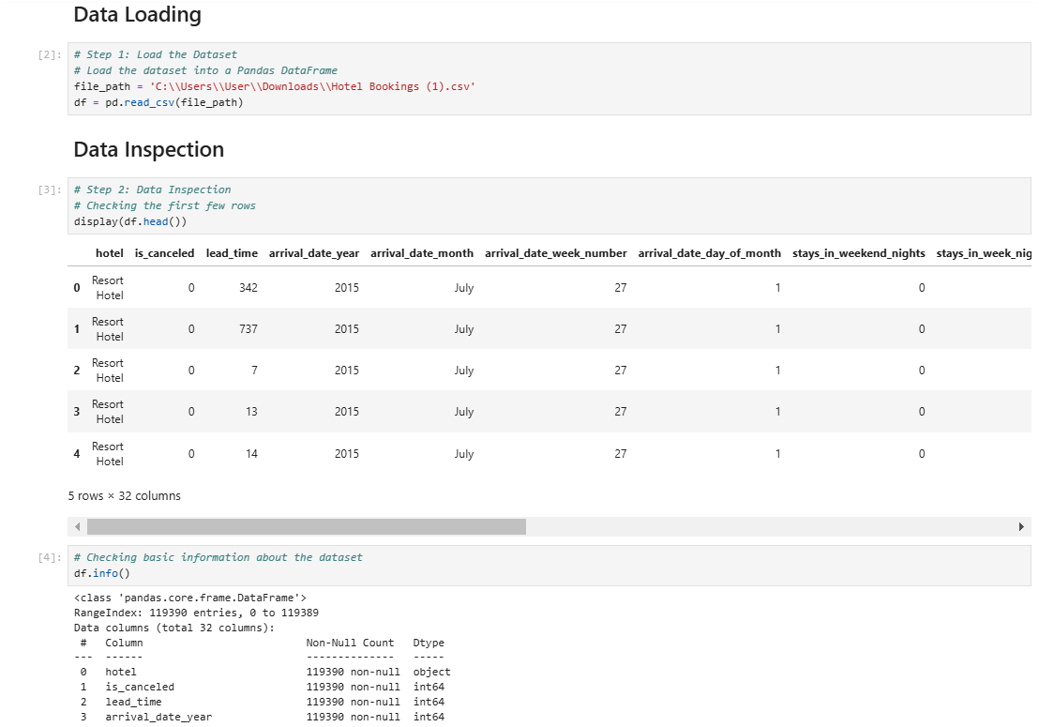

Data Loading
Dataset Overview
• Loaded dataset into a Pandas DataFrame.
• Contains information about hotel bookings.

Slide 7


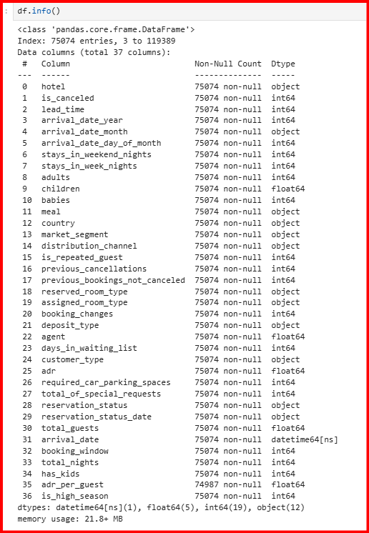

Data Inspection
Initial Data Inspection
Identifying Duplicates
Handling Missing Values
• Checked first few rows and basic information (data types, non-null counts).
• Identified immediate issues.
• Discovered 31,994 duplicate rows.
• Removed duplicates to ensure accuracy of insights.
• Identified columns with missing values, particularly 'company' and 'agent'.
• Dropped 'company' due to high missing values.
• Handled other missing values through appropriate methods (dropping or imputing).

Slide 8
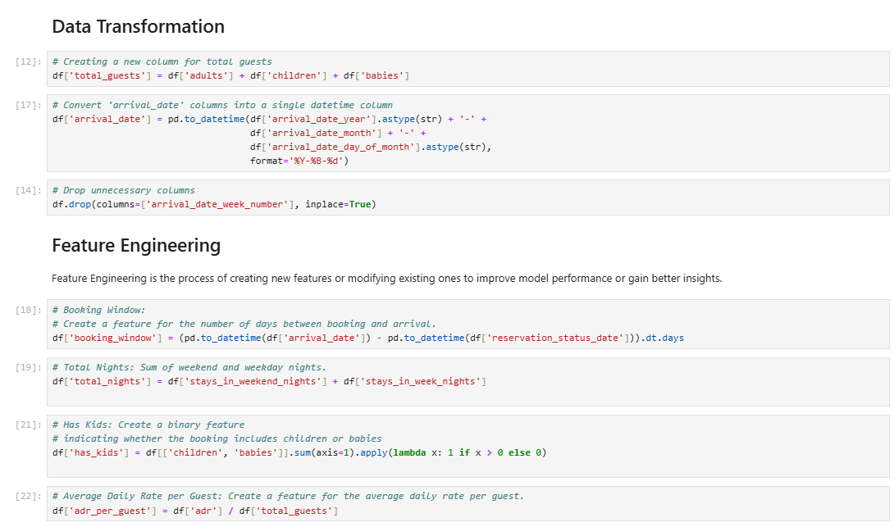
3. Data Transformation and Feature Engineering

Slide 9

Data Transformation
Column Transformation
Created new columns and transformed existing ones.
Combined 'arrival_date_year', 'arrival_date_month', and 'arrival_date_day_of_month' into a single 'arrival_date' column.
Create total_guests: Sum of adults, children, and babies.

Slide 10

Feature Engineering
New Feature Creation
Engineered new features for deeper insights.
Created 'booking_window' feature (days between booking and arrival).
Created 'total_nights' feature (sum of weekend and weekday nights).
Create adr_per_guest: Average Daily Rate per guest

Slide 11

4. Data Visualization and Insights

Slide 12

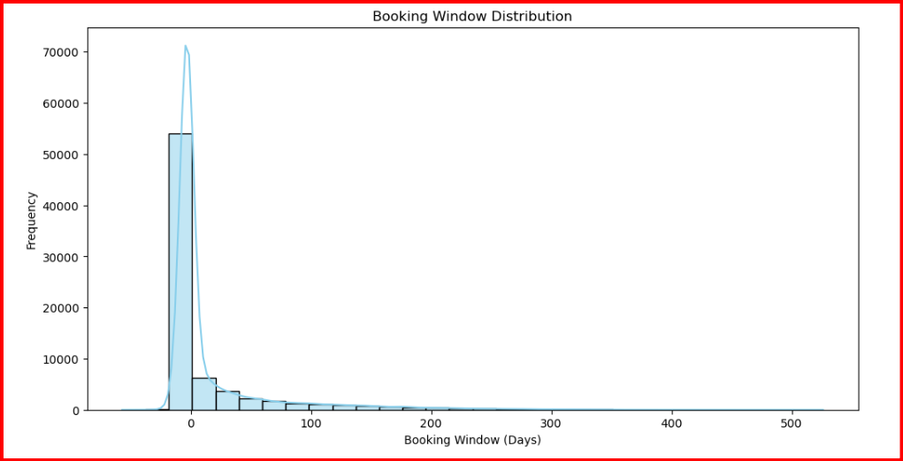
Booking Window Distribution
The highest frequency of bookings occurs within a short window (close to 0 days).
As the booking window increases, the frequency drops significantly.
hotels may not need to focus much on long-term booking strategies.
Visualization Insights

Slide 13

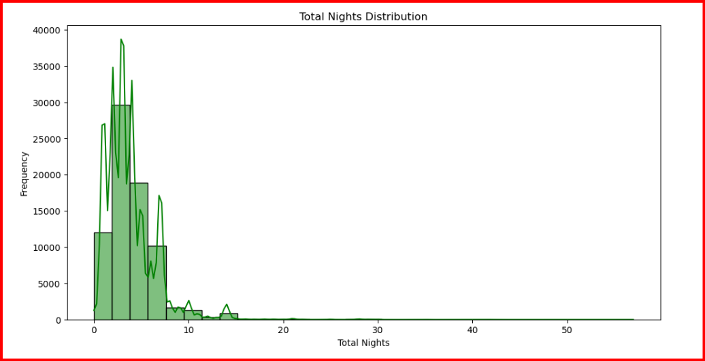
Total Nights Distribution
Stay Duration Insights
The histogram shows that the majority of bookings are for shorter stays, with most bookings falling between 0 and 5 nights.
Histograms are excellent for visualizing the distribution of a single continuous variable. They allow us to see the frequency of different ranges of values

Slide 14

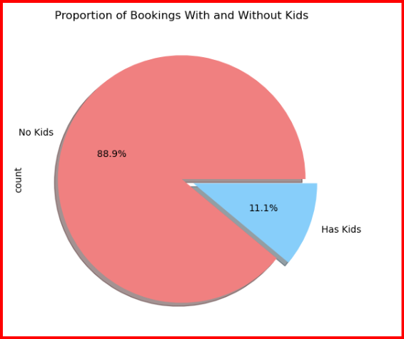
Proportion of Bookings With and Without Kids
Customer Demographics
• Pie chart showed 88.9% of bookings are made without children.
• Indicates most customers are adults traveling alone or with other adults.

Slide 15
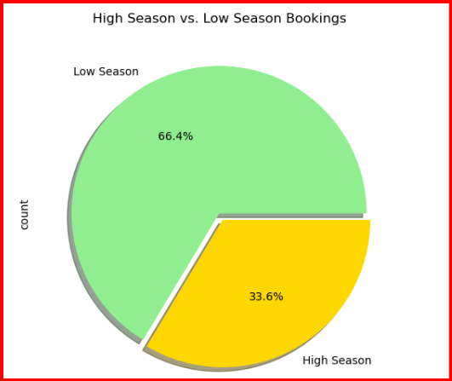

High Season vs. Low Season Bookings
Seasonal Booking Trends
Why Pie charts?
Showing Parts of a Whole – When you need to display how a total is divided into different categories.
1
Pie charts revealed 66.4% of bookings are made during the low season.
2
Indicates potential opportunities for targeted promotions during peak times.

Slide 16

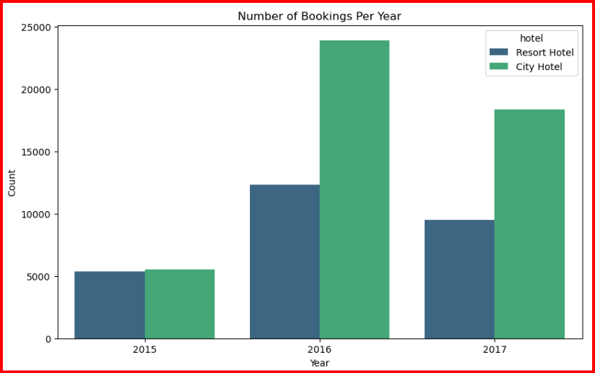
Number of Bookings
Per Year
Insights
The highest number of bookings was observed in 2016, with City Hotel bookings reaching nearly 25,000 and
Resort Hotel bookings around 15,000.
City hotels have more booking than resort hotel.
Why bar chart?
A bar chart is used to compare categorical data, making it ideal for analyzing trends over time. Comparing Different Categories, howing Trends Over Time (Discreet Intervals) .

Slide 17

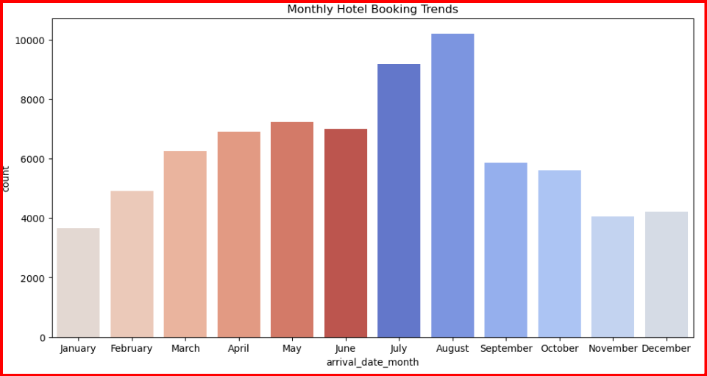
Monthly Hotel
Booking Trends
Insights:
July and August show higher bookings, it indicates these are peak months.
Hotels can increase room rates during these months
A bar chart is used when you want to compare categorical data across different groups.

Slide 18

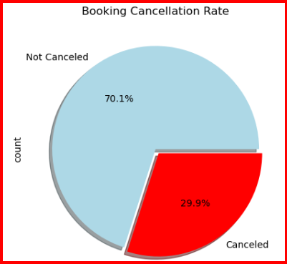
Booking Cancellation Rate
Insights:
①
②
The cancellation rate is 29.9%.
This can inform policies to reduce cancellations.
To reduce the Bookig Cancellation, hotels should consider stricter cancellation policies such as penalty for cancelling the last moment or incentives for non-cancelled bookings.
Showing Parts of a Whole – When you need to display how a total is divided into different categories.

Slide 19
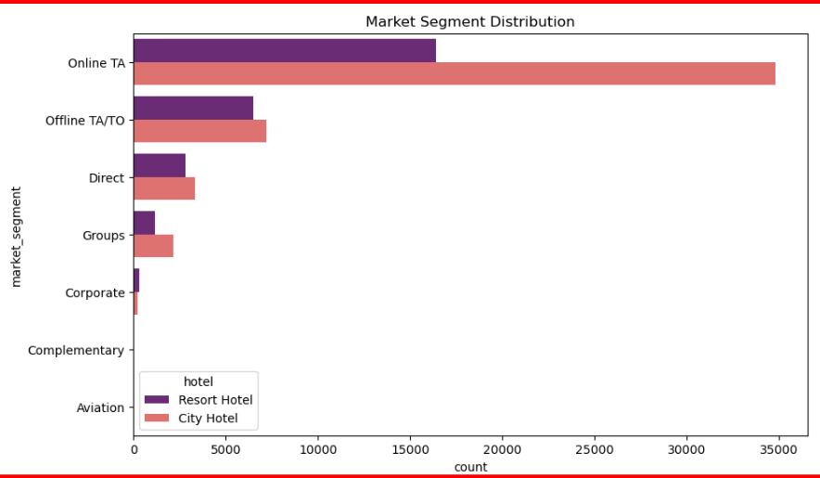
Which Market Segment Brings the Most Guests?
Insights:
The "Online TA"segment appears to be the most dominant for both types of hotels, with the highest count of bookings.
This could indicate that the City Hotel is more popular or has a larger capacity.
After "Online TA," the "Offline TA/TO" segment is the next most popular, followed by "Direct" bookings.
Comparing Different Categories, howing Trends Over Time (Discreet Intervals) , Ranking Data , Highlighting Differences Clearly ,

Slide 20
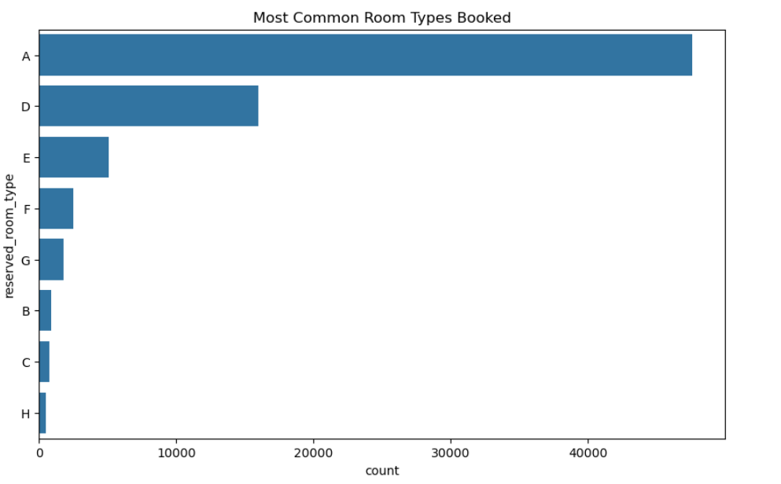
What is the most common room type booked?
Insights:
Room type "A" is the most frequently booked, indicating that it is the most popular choice among guests. Room types "D" and "E" also show significant booking counts, suggesting they are also preferred by guests, though not as much as type "A".
Room types like "L", "P", and "F" have much lower booking counts.

Slide 21
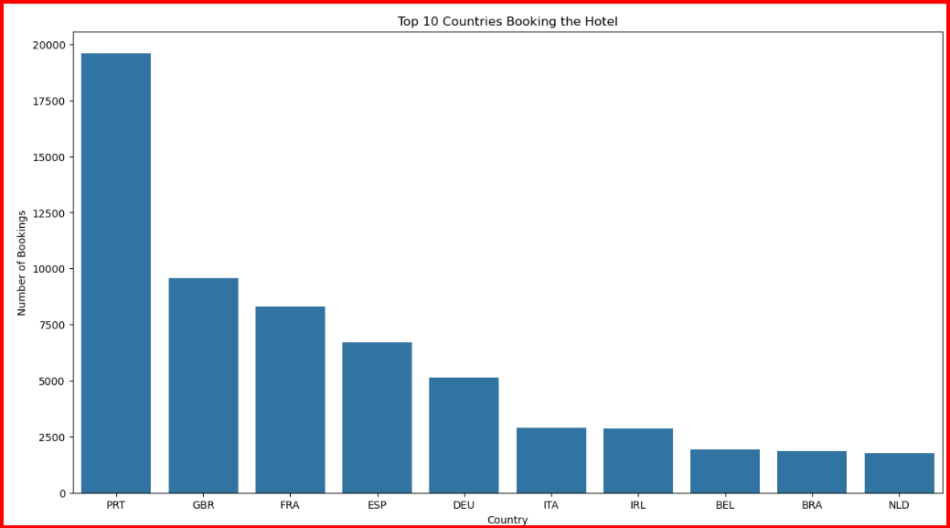
Top Ten Countries Booking The Hotel
Insights:
Portugal (PRT) has the highest number of hotel bookings, with approximately 19,000 bookings. This indicates a strong demand for hotel accommodations in Portugal.
After Portugal, the United Kingdom (GBR) comes in second with around 10,000 bookings, followed by France (FRA) with 8,000 bookings.

Slide 22
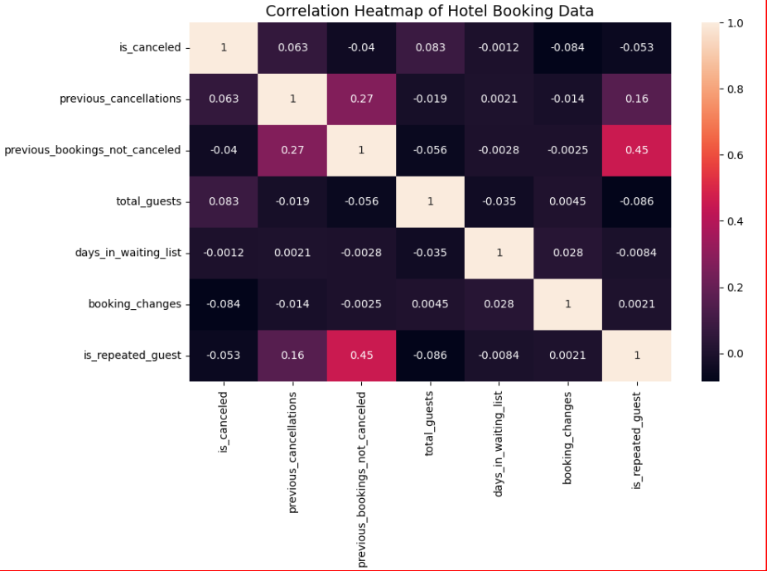
Correlation Heatmap Of Hotel Booking Data
Insights:
There's a moderate positive correlation (0.45) between "previous bookings not canceled" and "is repeated guest." This means that guests who haven't canceled previous bookings are more likely to return.
The highest correlation is with "previous cancellations" (0.063) and "total guests" (0.083), indicating that cancellations are not strongly influenced by these factors.
Most of the variables in the dataset show very weak or negligible correlations with each other, suggesting that they are relatively independent.

Slide 23
A heatmap is used to visualize relationships between variables using color gradients. It helps to quickly identify patterns, correlations, or intensities in data.
When dealing with large and complex datasets, heatmaps provide an intuitive way to spot trends.
Highlighting Intensities – Useful for showing high/low values in datasets (e.g., temperature maps, population density).

Slide 24

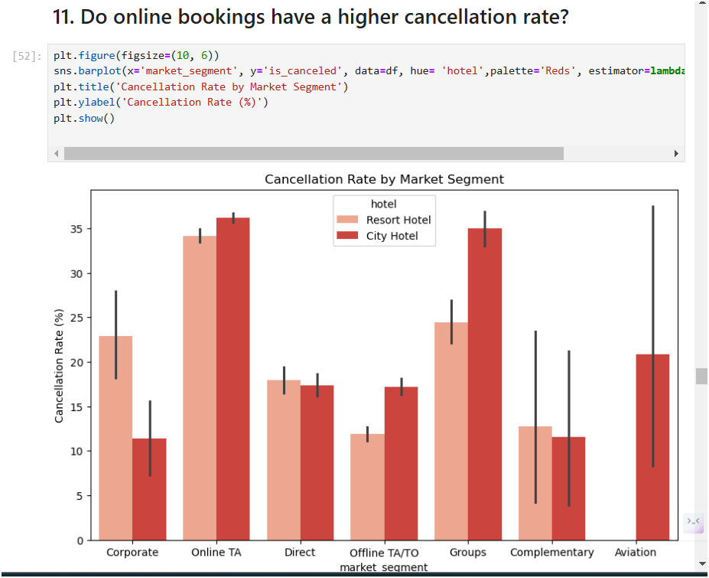
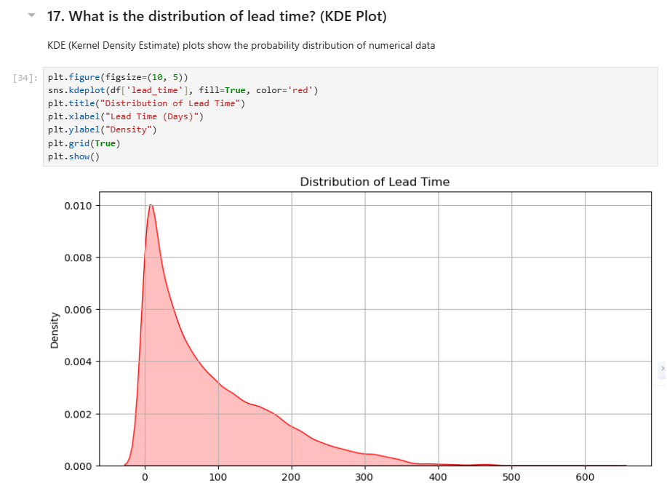
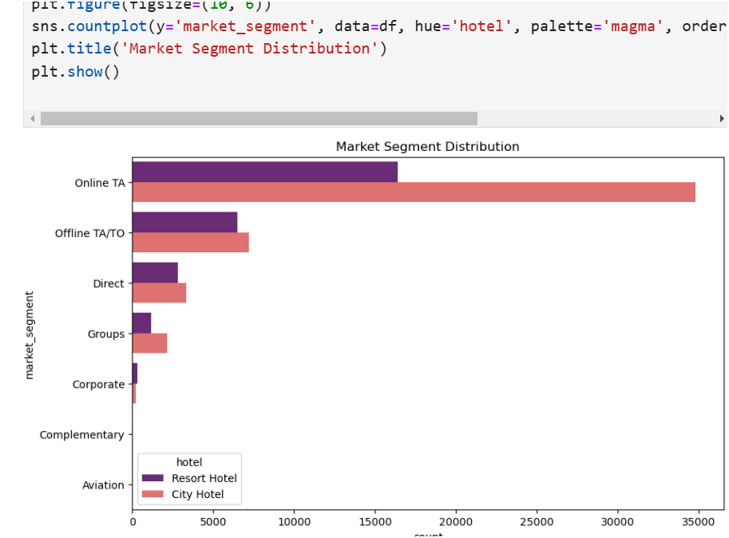
Booking Cancellation Trends
Guest Booking Patterns
Impact of Total Guests on Booking Outcomes
Online Travel Agents (OTA) and Groups have the highest cancellation rates, while Direct and Corporate bookings have lower cancellation rates.
Most bookings happen with very short lead times, but a few bookings have significantly longer lead times.
Online Travel Agents (OTA) dominate the market, followed by Offline TA/TO, while segments like Corporate and Aviation have minimal contributions

Slide 25
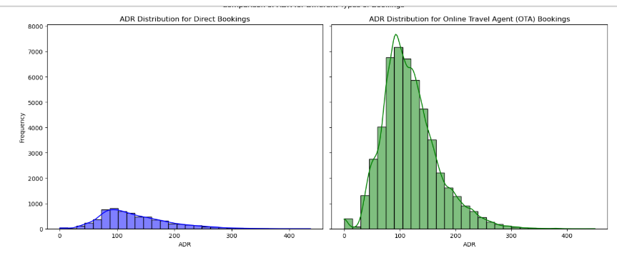
ADR of Different Types of Bookings- Subplots
Insights:
OTA bookings have higher and more spread-out ADR values, while direct bookings mostly stay around 50.
Direct bookings are more consistent, whereas OTA bookings have a wider range of ADR, indicating varied pricing.
Solution:
Optimize pricing strategies by leveraging higher ADR potential from OTAs while offering loyalty discounts for direct bookings.

Slide 26

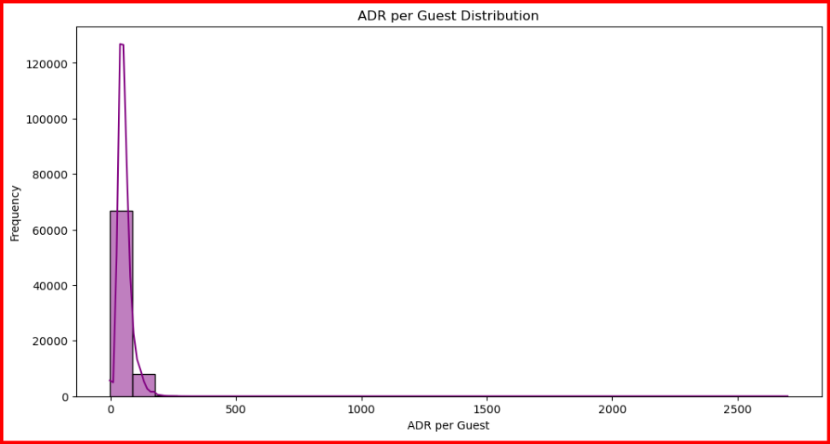
ADR per Guest
Distribution
Pricing Insights
The histogram shows that the majority of ADR (Average Daily Rate) per guest values are concentrated near the lower end of the range.
This indicates that most bookings have a relatively low ADR per guest.
While higher rates are less common, they do exist in the dataset..

Slide 27

Key Insights
Summary of Findings
Online Travel Agencies (OTAs) have highest cancellation rate at around 35%.
Followed by Groups(25%), Corporate and Direct Bookings (15-20%), ect
Room Type A has higher average daily rate (ADR) and several outliers.
Room Types B to H has lower ADRs with narrower ranges and fewer outliers.
Similar average number of special requests for both canceled and non-canceled bookings.
Most bookings have a few requests, with rare high-request bookings.
Highest bookings in August. July and August being the busiest months
Majority of bookings have short lead times(50 days).
Long tail indicating some bookings made well in advance.
Transient Customers have Highest ADR around 115 followed by Contract Customers having Lower ADR around 95.

Slide 28

Practicle Business Solutions
Recommendations
Marketing Strategies: Targeted campaigns for peak months; special deals during off-peak.
Customer Retention: Loyalty programs for customers with no cancellations.
Dynamic Pricing: Adjust rates based on demand and lead time.
Booking Policies: Flexible booking options and non-refundable deposits to reduce cancellations.
Operational Improvements: Optimize staffing for peak seasons; collect guest feedback for improvement.
Encourage non-refundable deposit options to reduce cancellations.

Slide 29

6. Conclusion

Slide 30


Conclusion
Project Summary
• EDA project on hotel bookings provided valuable insights for strategic decision-making.
• Recommendations aim to improve occupancy rates, reduce cancellations, and enhance customer satisfaction.

Slide 31


